Slide 1
dbX2 Control Flow Walk Through
Client
Margin Service
Margin Calculation

Slide 2
Client – submit service requests to datasynapse manager
margin (List<Integer> list) {
sess = ServiceFactory.getInstance().createService(SERVICE_LOCATOR);
BasicServiceHandler handler = new BasicServiceHandler();
for (Integer i : list)
  sess.submit(“margin”, new Object[] {i}, handler);
sess.waitUntilInactive(0);
handler.report();
return handler.getExceptions().size();
}
This function call is supposed to be inside a thread, which launched by some scheduler.

Slide 3
Client -- Exception handling
class BasicServiceHandler implements ServiceInvocationHandler {
  private LinkedList<DBXServiceFailure> _exceptions = new LinkedList<DBXServiceFailure>();
  public void handleError(ServiceInvocationException arg0, int arg1) {
    String trace = arg0.getTrace();
    java.util.Properties prop = arg0.getEngineProperties();
    _LOG.info("DataDir: " + prop.get("dataDir"));
    Throwable t = arg0.getCause();
    DBXServiceFailure failure = new DBXServiceFailure(t);
    _exceptions.add(failure);
  }
  public void handleResponse(Serializable arg0, int arg1) {}
}

Slide 4
Client – a sample of log message
After each batch, we have some summary at client side:
2009/05/05 14:56:00:852 [main] ERROR Service Input -- EntityId: 5623 with batch id: 205383
2009/05/05 14:56:00:852 [main] ERROR Service Input -- EntityId: 5776 with batch id: 205391
2009/05/05 14:56:00:852 [main] ERROR Service Input -- EntityId: 5926 with batch id: 205407
2009/05/05 14:56:00:852 [main] ERROR Service Input -- EntityId: 5931 with batch id: 205408
2009/05/05 14:56:00:852 [main] ERROR Service Input -- EntityId: 6641 with batch id: 205514
2009/05/05 14:56:00:852 [main] ERROR Service Input -- EntityId: 5489 with batch id: 205351
Also with the detail in the blade log
…..
at com.db.dbxmargin.domain.InputPosition.assignGMV(InputPosition.java:707)
at com.db.dbxmargin.domain.InputPosition.flag(InputPosition.java:645)
…...

Slide 5
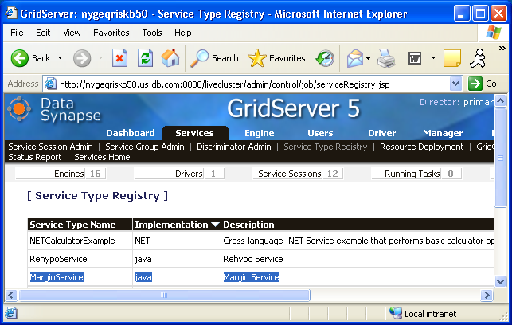
Margin Service – register a service on datasynapse

Slide 6
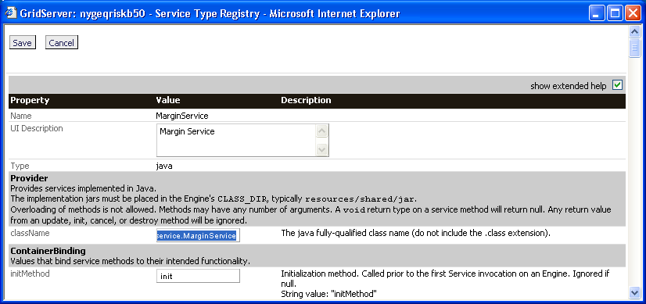
Margin Service – register a service on datasynapse
Key point is to associate service name with fully qualified class name

Slide 7
Margin Service – Entry Point
public void margin(ServiceInput input) {
  Portfolio portfolio = PortfolioFactory.createPortfolio(input);
  MarginMethodology marginMethodology = MethodlogyFactory.createMethodlogy(input);
  portfolio.loadEnvironment();
  portfolio.loadEntityMapping();
  portfolio.loadPosition();
  marginMethodology.init(portfolio);
  marginMethodology.calc(portfolio); //margin entry point
  //generate underlying report, front page, risk value reports,
  // which do not belong to any strategy
  portfolio.genReport();
  portfolio.persist(); //call data service to persist margin result
}

Slide 8
Margin Calculation
void calc(Portfolio portfolio) {
  processStrategy(_specialStrategy);
  for (IMarginStrategy strategy : _methodology) {
    strategy.collectPosition();
    strategy.processPosition();
    strategy.collectRiskValue();
  }
  for (IMarginStrategy strategy : _methodology) strategy.calc();
  checkConsistency(portfolio);
  processStrategy(_tenorReliefer);
  portfolio.overrideMargin();
  processStrategy(_fxStrategy);
  for (IMarginStrategy strategy : _methodology) strategy.genReport();
  processReport(_specialStrategy);
  processReport(_fxStrategy);
}

Slide 9
Margin Strategy Interface
Trivia are removed for clarity
//setup position filter that would be called in collectPosition
//only position returns true will be collected in the strategy
public abstract void setPositionFilter(IPositionFilter filter);
//collect positions that would be margined in the strategy
abstract public void collectPosition();
//netting, adjust collected positions
//and generate synthetic position if necessary
abstract public void processPosition();
//major extension point to implement strategy logic
abstract public void calc();
//collect risk values. The collectors in the portfolio will also be called
public abstract void collectRiskValue(); //detail later
//generate display results and persist all of them.
public abstract void genReport();

Slide 10
Margin Strategy Base Structure
protected String _name = null;
protected Portfolio _portfolio;
//stored collected positions
protected List<InputPosition> _inputs = null;
//stored netted positions risk value collector will go through all detail positions
protected Map<Integer, SimpleMarginPosition> _agrResults = null;
//intermediate storage for netting
private Map<Integer, Netter> _netterMap = null;
protected IPositionFilter _filter = null;
protected List<IRiskValueCollector>_collectors;
protected HashMap<String, BaseMarginRule> _ruleMap = null;

Slide 11
Margin Strategy Base Implementation
void collectPosition() {
for (InputPosition pos : _portfolio.getInputPosition())
  if (_filter.isQualified(pos)) _inputs.add(pos);
}
//base implementation
public void processPosition() {
/* neeting generates NettedMarginResult and aggregated //SimpleMarginPosition stored in agrResults, which risk value collectors will go through */
netting();
}
//some common help, etc
protected void addMarginPosition(IMarginPosition mpos) {
mpos.setCalcStrategy(getStrategyType());
_portfolio.addMarginPosition(mpos);
}

Slide 12
Some detail about collectRiskValue()
Base implementaion in Strategy
void collectRiskValue() {
  List<IRiskValueCollector> x = _portfolio.getCollectors();
  collectRiskValue(x);
  collectRiskValue(_collectors);
}
void collectRiskValue(List<IRiskValueCollector> list) {
  for (IRiskValueCollector c : list) {
    Map map = _portfolio.getRiskValue(c.getName());
    c.collect(map, _agrResults);
    c.derive(map);
  }
}

Slide 13
IRiskValueCollocter<T extends IRiskValue>
public void setFilters(List<IDetailMarginPositionFilter> filters);
public String getKey(InputPosition pos);
//could be an extending point, but not necessary in most cases
public Map<String, T> derive(Map<String, T> map);
public String getName();
public void setName(String name);
public void collect(Map<String, T> map, List<SimpleMarginPosition> list);
public void collect(Map<String, T> map, Map<Integer, SimpleMarginPosition> list);

Slide 14
IRiskValue interface and an example
IRiskValue : void collect(DetailMarginPosition pos);
public class MktValue implements IRiskValue {
  protected double _gmv = 0;
  public void collect(DetailMarginPosition pos) {
    InputPosition i = pos.getInputPosition();
    double mv = i.getGmv();
    mv = mv * pos.getMarginQty() / (i.getMarginQty() * i.getSecurity().getRatio());
    _gmv += Math.abs(mv);
  }
}

Slide 15
Two implementation of IRiskValueCollecter
class SummaryCollector<T extends IRiskValue>
  extends RiskValueCollector<T> {
    public String getKey(InputPosition pos) {
    return this._keyName;
    }
  }
public class MethodCollector <T extends IRiskValue>
  extends RiskValueCollector<T> {
    public String getKey(InputPosition pos) {
      try {
      return _method.invoke(pos.getSecurity()).toString();
      }
      catch (Exception e) {
      throw new DBXError(e);
      }
    }
  }

